Slide 1

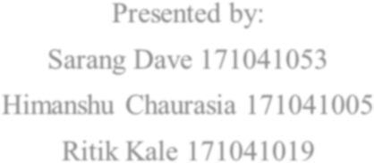




A. C. Patil College of Engineering, Kharghar
Department of Computer Engineering
Jawahar Education Society’s
Where knowledge is second nature
(Accredited by NAAC)
Gesture Based Mouse
Using OpenCV
Project Guide
Prof. A. R. Sonule
Date: 12/05/2021

Slide 2
Introduction
Modern optical mice work by using an optoelectronic sensor (essentially, a tiny low-resolution video camera) to take successive images of the surface on which the mouse operates.
Optical mice capture one thousand successive images or more per second. Depending on how fast the mouse is moving, each image will be offset from the previous one by a fraction of a pixel or as many as several pixels.
Optical mice mathematically process these images using cross correlation to calculate how much each successive image is offset from the previous one.

Slide 3
Introduction
Common types of mice include:
Mechanical mice
Laser mice
LED mice
Trackball mice

Slide 4
Literature Survey
Topic | Date of Conference/I NSPEC Accession Number | Summary | Merit | Demerits
Gesture Based Mouse Control | 29-31 March 2018/ 18132526 | In this paper a gesture recognition models is designed which recognize hand gestures that is down, up, left, tick, right and cross, based on the input signal from three-axis accelerometer. Mouse control based on Gesture interaction takes advantage of continuity and dynamics of the user's movement of the hand to control the mouse movement. | More precision was observed in terms of dragging and clicking. | Hardware component were required to meet the ends.

Slide 5
Literature Survey
Topic | Date of Conference/INS PEC Accession Number | Summary | Merits | Demerits
Design of control system based on hand gesture recognition | 27-29 March 2018/17769461 | Vision-based dynamic gesture recognition is an important means of human-computer interaction. This paper designs a dynamic gesture recognition control system based on USB single camera. After obtaining the image through the camera, the original image is binarized, eroded, smoothed and filled with holes, then the circumscribed rectangles and the centroid points of the gesture image are tracked, then the movement direction of the gesture is determined according to the motion track. Finally, through the gesture control movement of the mouse pointer to move and simulate the left-click operation. | The test results show that the system recognition rate is high, therefore the research has some practical values. | It requires a lot of processing to carry out the process.

Slide 6
Problem Statement
The problem with current gen computer mice is that they only offer a life of about 10,000 clicks. After the user surpasses this number, there is no guarantee and no means to estimate how long will the mouse further last. The growing number of physical computer accessories and improper handling of e-waste also contributes to the overall pollution level of the planet. This project aims to tackle both problems at the same time by using gesture based commands to send mouse input to a PC. This, in turn, completely eliminates the need of a physical entity to act as a mouse and hence, a drastically lower amount of e-waste would be produced.

Slide 7
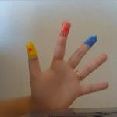
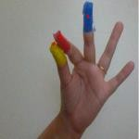
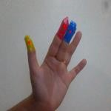
Proposed System
This code will be written in Python3. It will use the cross-platform image processing module OpenCV and implement the mouse actions using Python-specific library PyAutoGUI.
The video will be captured by the webcam and will be processed so that only the three colored fingertips are extracted. Their centers are calculated and depending upon their relative positions it is decided that what action is to be performed.

Slide 8
Observation/Conclusion
Hence, we will have designed a project using concepts of image processing and tools like OpenCV, PuAutoGUI etc. OpenCV is used to capture hand gestures. A video stream is captured from the webcam. These images are processed (erosion, dilation etc) and the centroids from the center of the coloured tapes are extracted. The position of the cursor is calculated and the cursor is positioned accordingly. Gestures are also supported, and are pre-defined.

Slide 9
Thank you.

